Slide 1
UNIVERSITY OF ZAGREB – FACULTY OF LAW
LIBRARY resources and services
https://www.pravo.unizg.hr/knjiznica
https://www.pravo.unizg.hr/en/library
Head:
Andrea Horić, Ph. D.
ahoric@pravo.hr
ERASMUS 2023, Faculty of Law , University of Zagreb

Slide 2
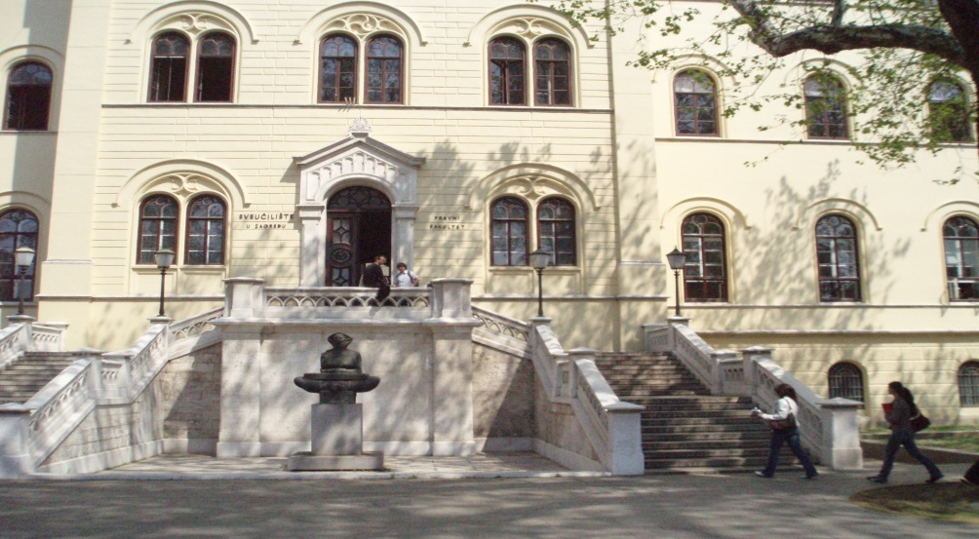
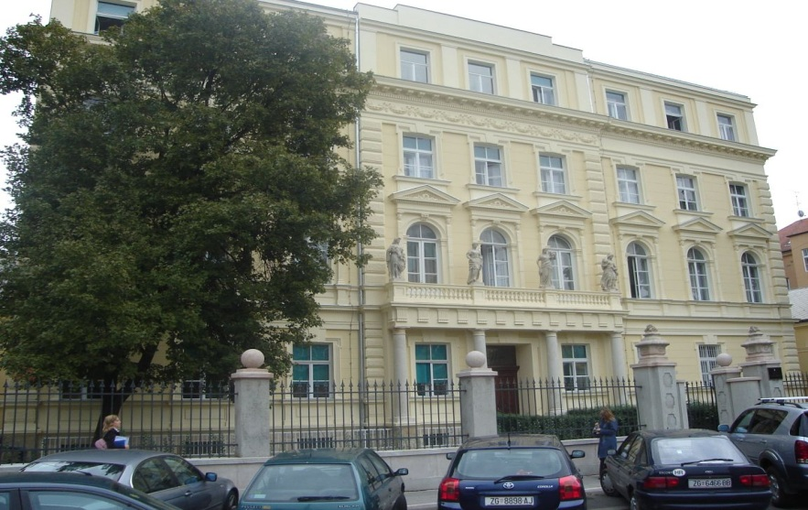
The Library is located at these two sites… prior to 2020 & earthquake
was
TRG REPUBLIKE HRVATSKE 14/I
TRG REPUBLIKE HRVATSKE 3
BOOK DEPARTMENT and European Documentation Centre (EDC)
P: 01/ 45 64 308
E: knjiznica@pravo.hr
Opening hours 09:00 am – 01:00 pm
Reading Room 08:00 – 06:00 pm
PERIODICALS DEPARTMENT
P: 01/ 45 97 546
E: knjiznica@pravo.hr
Opening hours 09:00 am – 01:00 pm
Reading Room : 09:00 – 06:00 pm

Slide 3
Library services under current circumstances
All other Library services, where possible, are available ONLINE:
Access to Library catalogue
Access to bibliographic, citation or full-text subscribed databases
Inter-library loan
Remote research support provided by our information specialists
Borrowing and photocopying at Trg Republike 3, basement
Bare in mind
New reading and computer room (ground floor, room 3)
No immediate access to books or periodicals
ERASMUS 2021, Faculty of Law, University of Zagreb

Slide 4
Essential services – borrowing, copying, reading and IT room
TRG REPUBLIKE HRVATSKE 3 - BASEMENT (entrance from the court yard behind the building)
ROOM 3 - GROUND FLOOR
Opening hours: 09:00 am – 01:00 pm on week days, upon prior appointment to prepare the needed materials
Reading room nr. 3 - 09:00 am – 18:00 pm on week days
For all queries and assistance please use our Library email:
knjiznica@pravo.hr
You will receive a reply in 24 to 48 hours

Slide 5
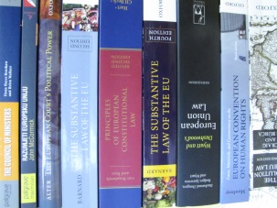
Borrowing and photocopying services
Handbooks can be borrowed for 30 days
In case you want to renew your loans, please send an email to: posudba.produzenje@pravo.hr or knjiznica@pravo.hr
Fines are charged for overdue books: 25 c per book and per day
Minor part of a book can be photocopied or scanned (not more than 15 % of the content)
Price of photocopying: 0,7 c per page
There is a computer available on the spot for those who want to search the Library catalogue or legal and other subscribed databases
Please make arrangements by email with our staff prior to visiting in person
ERASMUS 2023, Faculty of Law, University of Zagreb

Slide 6
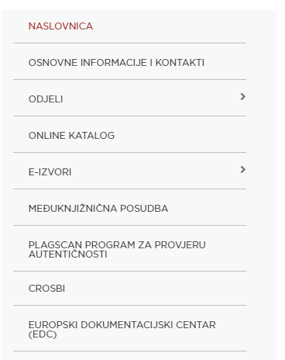
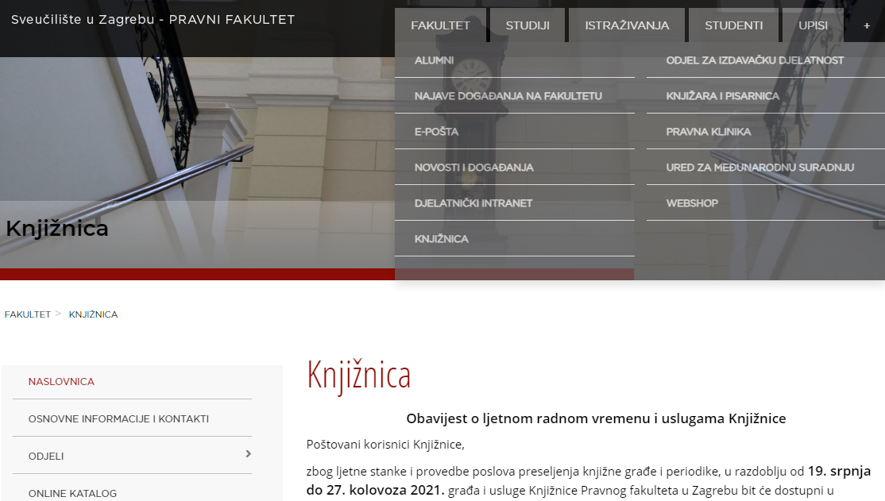
Online Library Services
on webpage in croatian
https://www.pravo.unizg.hr/knjiznica
Use the left menu on the Library homepage to access our catalogue, e-resources, databases, etc.
ERASMUS 2021, Faculty of Law, University of Zagreb

Slide 7
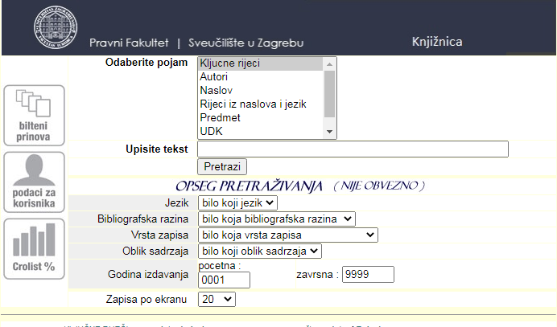
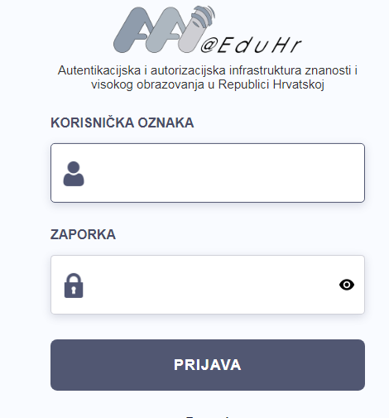
Online Library Services
Remote access to subscribed databases (use your AAI ID and password): https://www.pravo.unizg.hr/knjiznica/e-izvori
Check Library holdings using our online Library Catalogue at: https://www.pravo.unizg.hr/knjiznica/online_katalog

Slide 8
Online Library Services (Library Catalogue)
Search our Library Catalogue to find bibliographic data on library holdings
Send an email to knjiznica@pravo.hr in case you:
want to check availability of a title in our holdings
want to order a book from our storage
need access to full-text of a journal article from our holdings that is not available online
want to order photocopies or scans of specific materials

Slide 9
Online Library Services (subscribed databases)
Search Library databases remotely to find journals, full text articles and other publications
Send us an email to knjiznica@pravo.hr in case you:
have difficulties accessing a specific database
are not sure which database you should use for your research
need help in creating your search strategy
need assistance in accessing full text of an article

Slide 10
How to search
Library Catalogue
E-Resources agregators (Summon, EBSCO Discovery Service)
Legal databases

Slide 11
Library Catalogue – two search engines https://www.pravo.unizg.hr/knjiznica/online_katalog
Use this link to access the classic library search engine
…or link to Vero: a Google like search engine

Slide 12
Library Catalogue – Search Engine https://www.pravo.unizg.hr/knjiznica/online_katalog
The catalogue contains bibliographic data on library holdings
Books
Printed journals
Selected e-journals
Selected articles published in Croatian law journals
You can search by: key words (in Croatian), words in title (Croatian, English or other), author
You can add filters: language, time span, format (book, article, electronic resource, continuing resource, etc.)

Slide 13
Library Catalogue - Vero Search Engine
Type in some key words to get a list of results and narrow it down by using facetted filters left and right (author, format, subjects, language, year, etc.)

Slide 14
E-Resources
Please use the link below to access Library e-Resources with your AAI identity

Slide 15
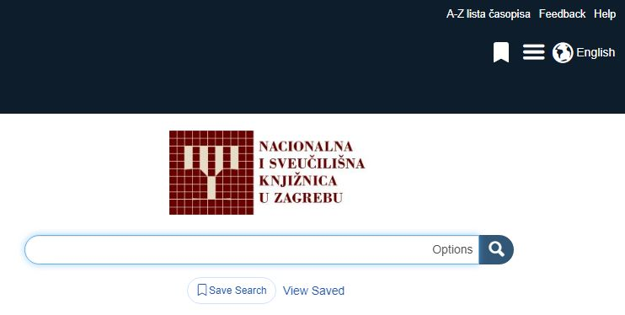
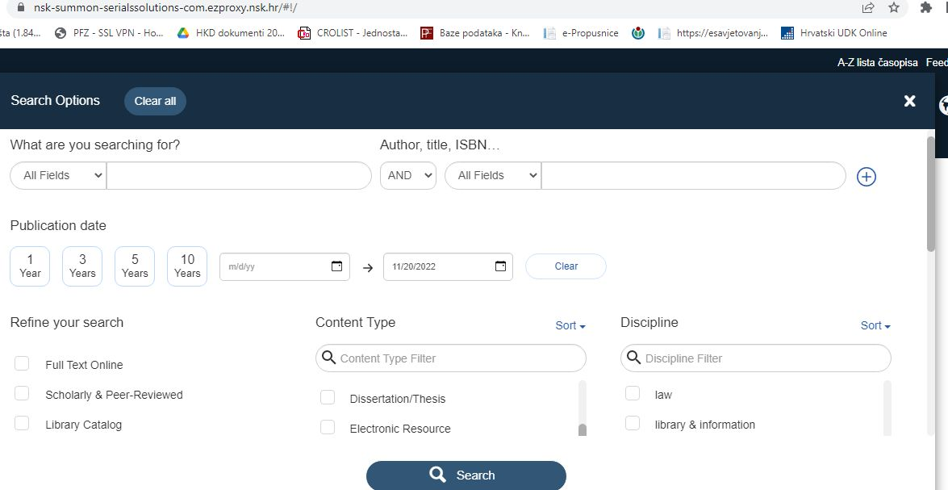
E-sources agreggators
SUMMON, EDS

Slide 16
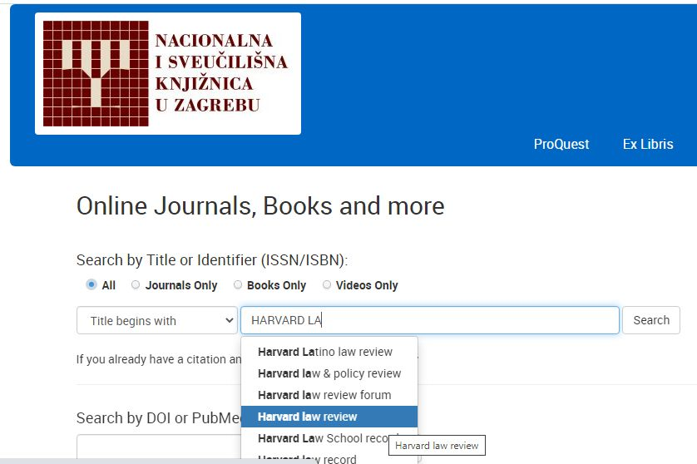
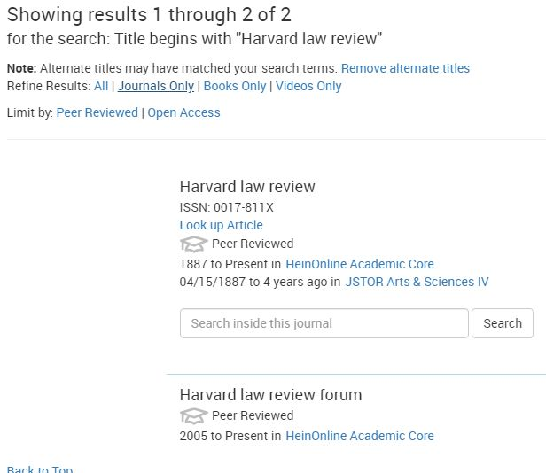
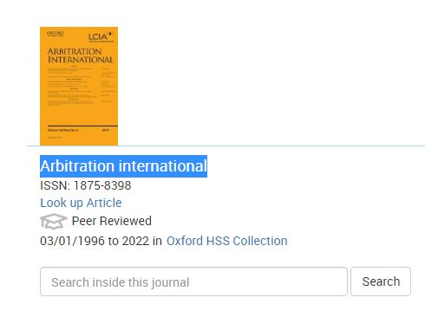
Reference journal search: Summon
Some of our subscriptions are yet to be listed
National access & subscriptions

Slide 17
E-Resources: example for all databases EBSCO Discovery Service (EDS)
After logging in, you can choose from a list of resources subscribed by the Faculty of Law.
To find e-journals, articles and other e-sources, choose EBSCO Discovery Service
EDS allows you to use single search engine to search multiple databases. Use advanced search form to add search criteria, and limit your search to LAW only.

Slide 18
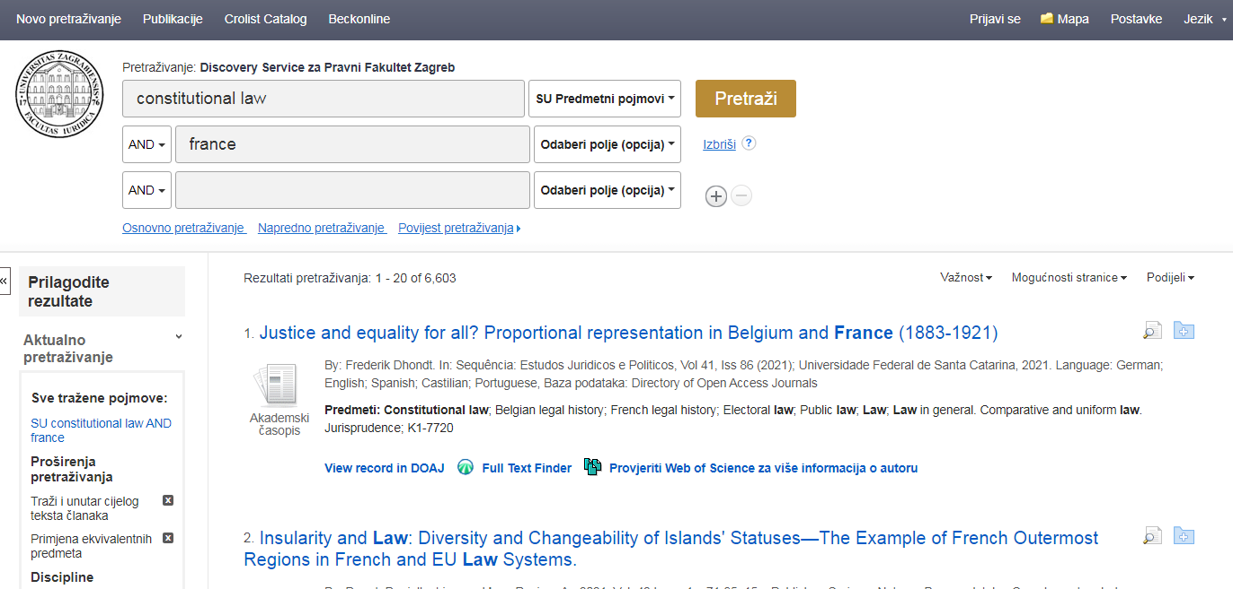
E-Resources: EDS – List of results
Narrow down your search results by choosing additional criteria (filters) from the menu on your left.
Choose „full text finder” to access text of an article

Slide 19
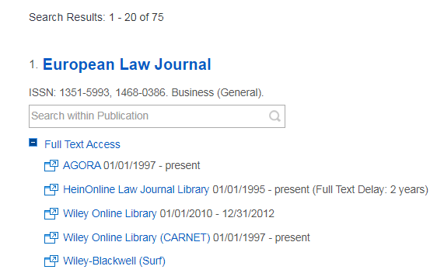
E-Resources: EDS – How to find e-journals by title and access full-texts
If you need to check contents of a specific journal, use „Publications” tab
Enter title of the journal to the search field
Finally you get a list of databases that contain full text of the journal you need.

Slide 20
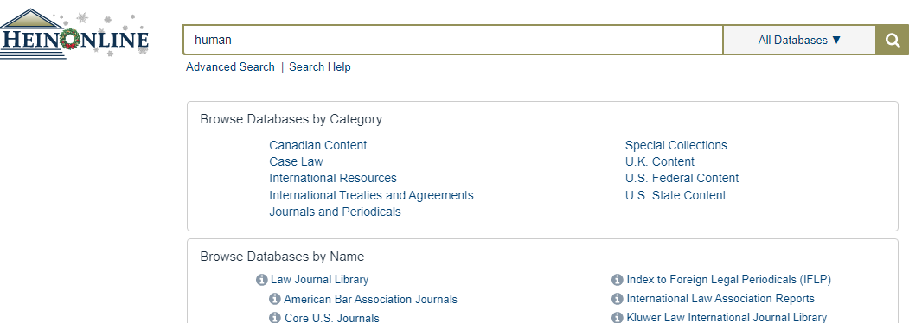
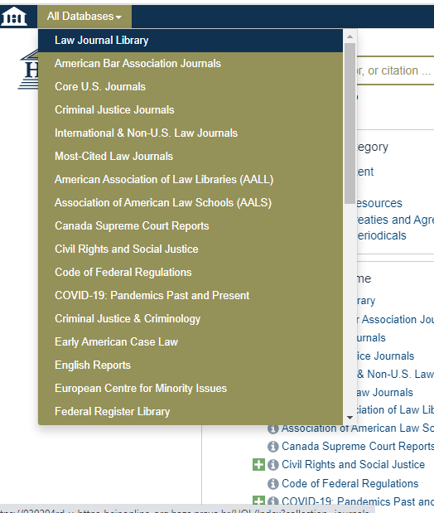
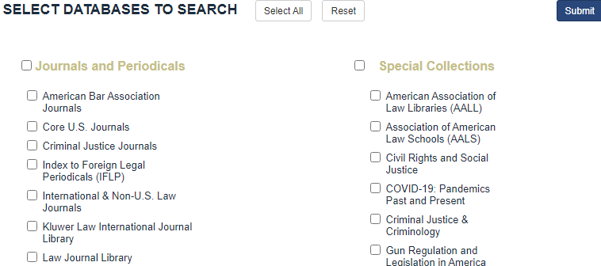
Hein Online database
Various options, search suggestions (synthax, knowledge base)
General and advanced search
Categories (databases, collectios – Law journals!)
ERASMUS 2023. Faculty of law, University of Zagreb

Slide 21
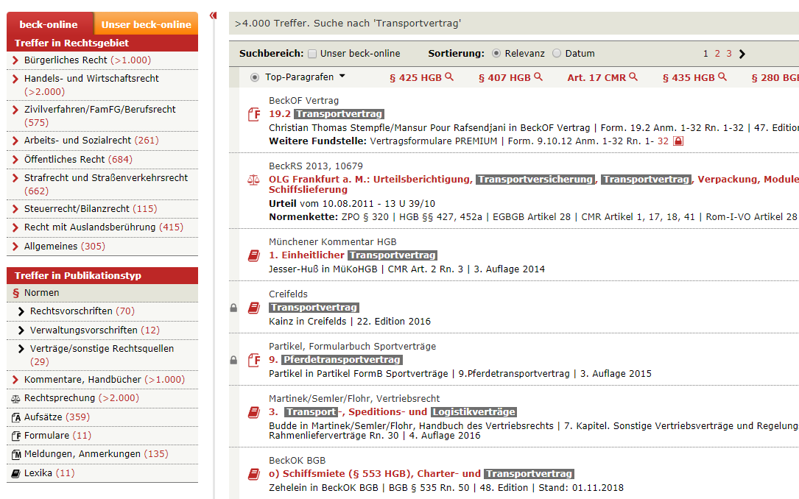
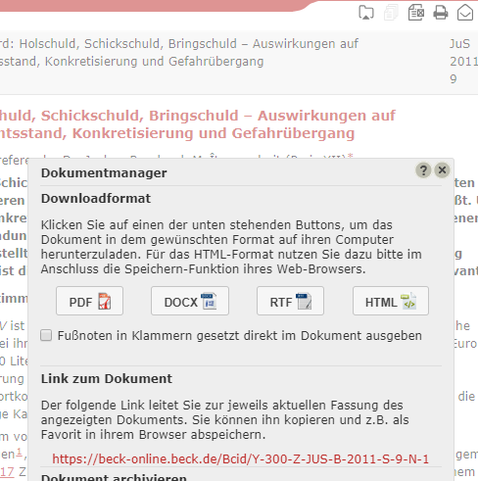
BECK ONLINE
Words autocompletion
Dowload - dokumentmanager
Choose type of work: articles, commentaries, jurisprudence, journals
ERASMUS 2023. Faculty of law, University of Zagreb

Slide 22
Other e-resources and databases available at the Law Library

Slide 23
EUROPEAN DOCUMENTATION CENTRE
Since 2014 our Law Library is host to the European Documentation Centre (EDC) and is part of the European Commission’s Europe Direct information network.
In case you need assistance and support in your research related to EU law and policies, please send an email to eu-info@pravo.hr with details of your information need.

Slide 24
Thank you and welcome to the Faculty of Law Library!
This presentation: on a library webpage in English:
https://www.pravo.unizg.hr/en/library

